Slide 1
Wearable Technologies: Overview
Revision Checklist: Essential points you should know after that section:
Define the term software, hardware and sensor Outline the key features of software, hardware and sensors Show the relationship between software and hardware Explain the role of a microcontroller Describe some of the advantages of wearable technologies Show decision support and wearable technologies can work together

Slide 2
Definition
“WEARABLE TECHNOLOGIES: “Fast development of electronics, radio communication systems and also textile industry enables modern technologies to be employed for the safety secure at workplaces to save life and health of workers. Various systems of wearable technologies and active clothing, which integrate electronic and control components into textile materials or worker’s wearable equipment, are being developed to this end”
Dosinas, A., M. Vaitkūnas, and J. Daunoras. "Measurement of Human Physiological Parameters in the Systems of Active Clothing and Wearable Technologies." Electronics and Electrical Engineering.–Kaunas: Technologija 7 (2006): 71.

Slide 3
Definition
“SOFTWARE: instructions that tell a computer what to do. Software comprises the entire set of programs, procedures, and routines associated with the operation of a computer system. The term was coined to differentiate these instructions from hardware.”
“HARDWARE: the physical components of a computer system. A set of instructions that directs a computer’s hardware to perform a task is called a program, or software program.”
http://www.britannica.com/EBchecked/topic/552496/software

Slide 4
Definition
“SENSOR: Sensors are hardware components that can provide your computer with information about your computer's location, surroundings, and more. Programs on your computer can access information from sensors, and then store or use it to help you with everyday tasks.”
http://windows.microsoft.com/en-gb/windows7/what-is-a-sensor

Slide 5
Building Blocks
Applications
Operating System
SOFTWARE
BIOS
HARDWARE
Hard drive
Sensors
Motherboard

Slide 6
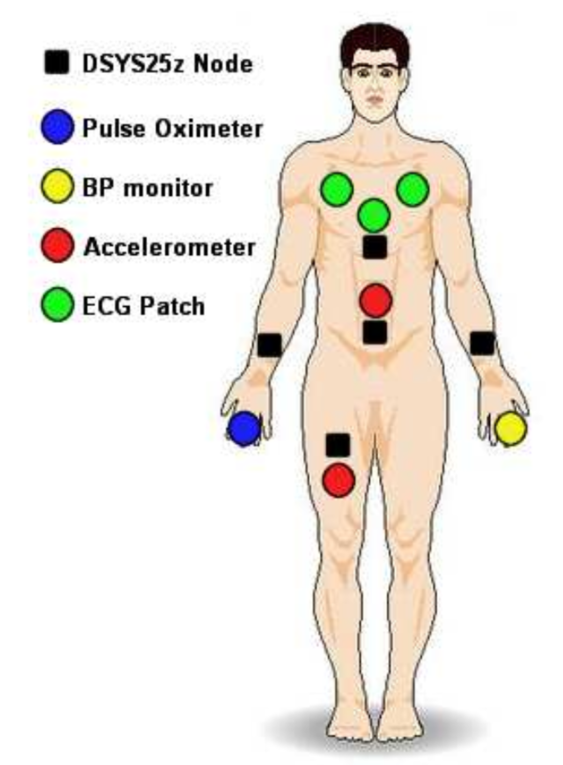
Microcontroller
Microcontroller: is an integrated chip that is often part of an embedded system. It includes a CPU, RAM, ROM, I/O ports, and timers like a standard computer, but because they are designed to execute only a single specific task to control a single system, they are much smaller and simplified so that they can include all the functions required on a single chip
O'Donovan, Tony, et al. "A context aware wireless body area network (BAN)." Pervasive Computing Technologies for Healthcare, 2009. PervasiveHealth 2009. 3rd International Conference on. IEEE, 2009.

Slide 7

Advantages of Wearable Technologies
Question: Decision Support, where does it fit in?
Question: What role can mHealth play?
1
Cloud Services
2
…….
N
Big Data

Slide 8
Summary
Putting it all together: Can you tick all the points from the revision checklist at the beginning of this chapter?
Define the term software, hardware and sensor Outline the key features of software, hardware and sensors Show the relationship between software and hardware Explain the role of a microcontroller Describe some of the advantages of wearable technologies Show decision support and wearable technologies can work together

